Slide 1

Problem
Clients do not have the capabilities to assess the values of their automotive assets to make business decisions.

Slide 2








 | No Installation Needed | Sensors Give Benefit to Car Outside of App | Protects Car Data From Insurance Companies | Provides Individualized Car Analytics | Multiple Sensors Used

Slide 3




The Automotix Team
Chief Commercial Officer
Chief Operations
Officer
Chief Engineer
UI/UX
Chief Engineer
Product Manager
Chief Engineer
Architect
Inbar Kodesh
Pallavi Bannai
Fares Takieddine
Shivani Chauhan
Audrey Becker
Stanford University
Computer Science & Economics
Carnegie Mellon University
Electrical & Computer Engineering
UIUC
Computer Science & Engineering
MIT
Computer Science & Engineering
University of Cincinnati
Computer Science & Mathematics

Slide 4
Solution
Automotix allows for users to receive a live evaluation of their vehicle based on current market trends.

Slide 5
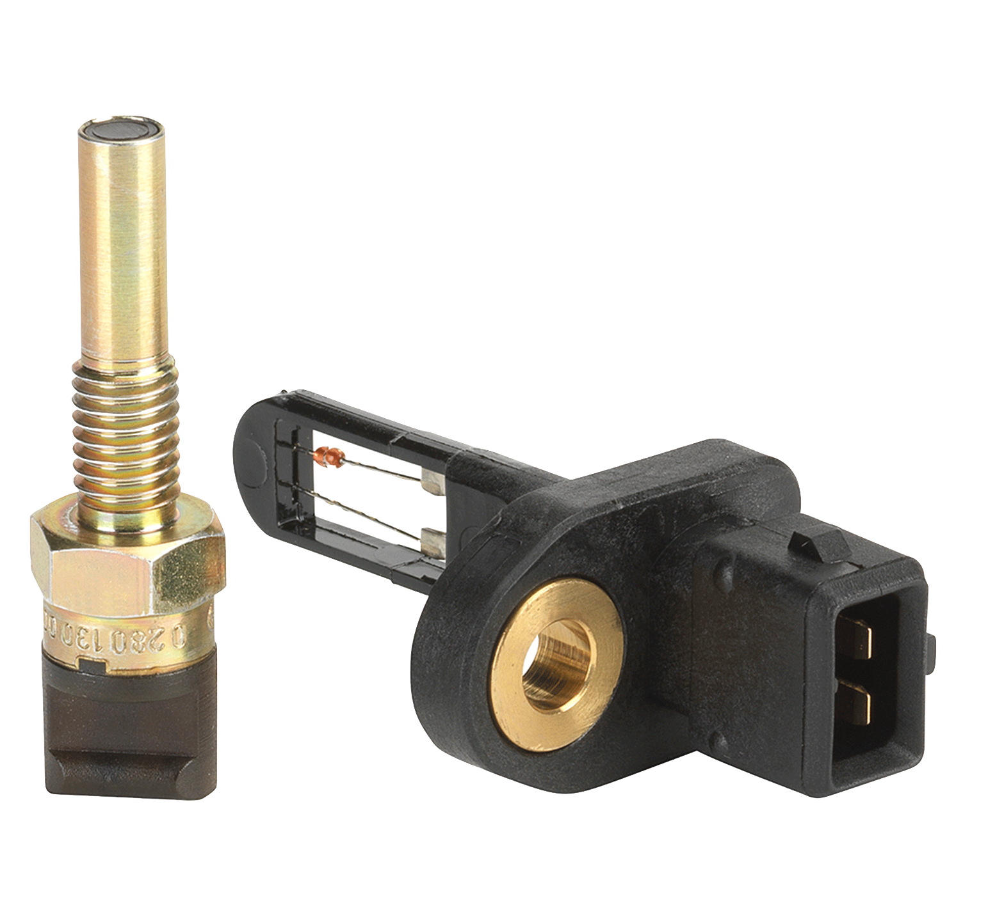
Bosch

Slide 6
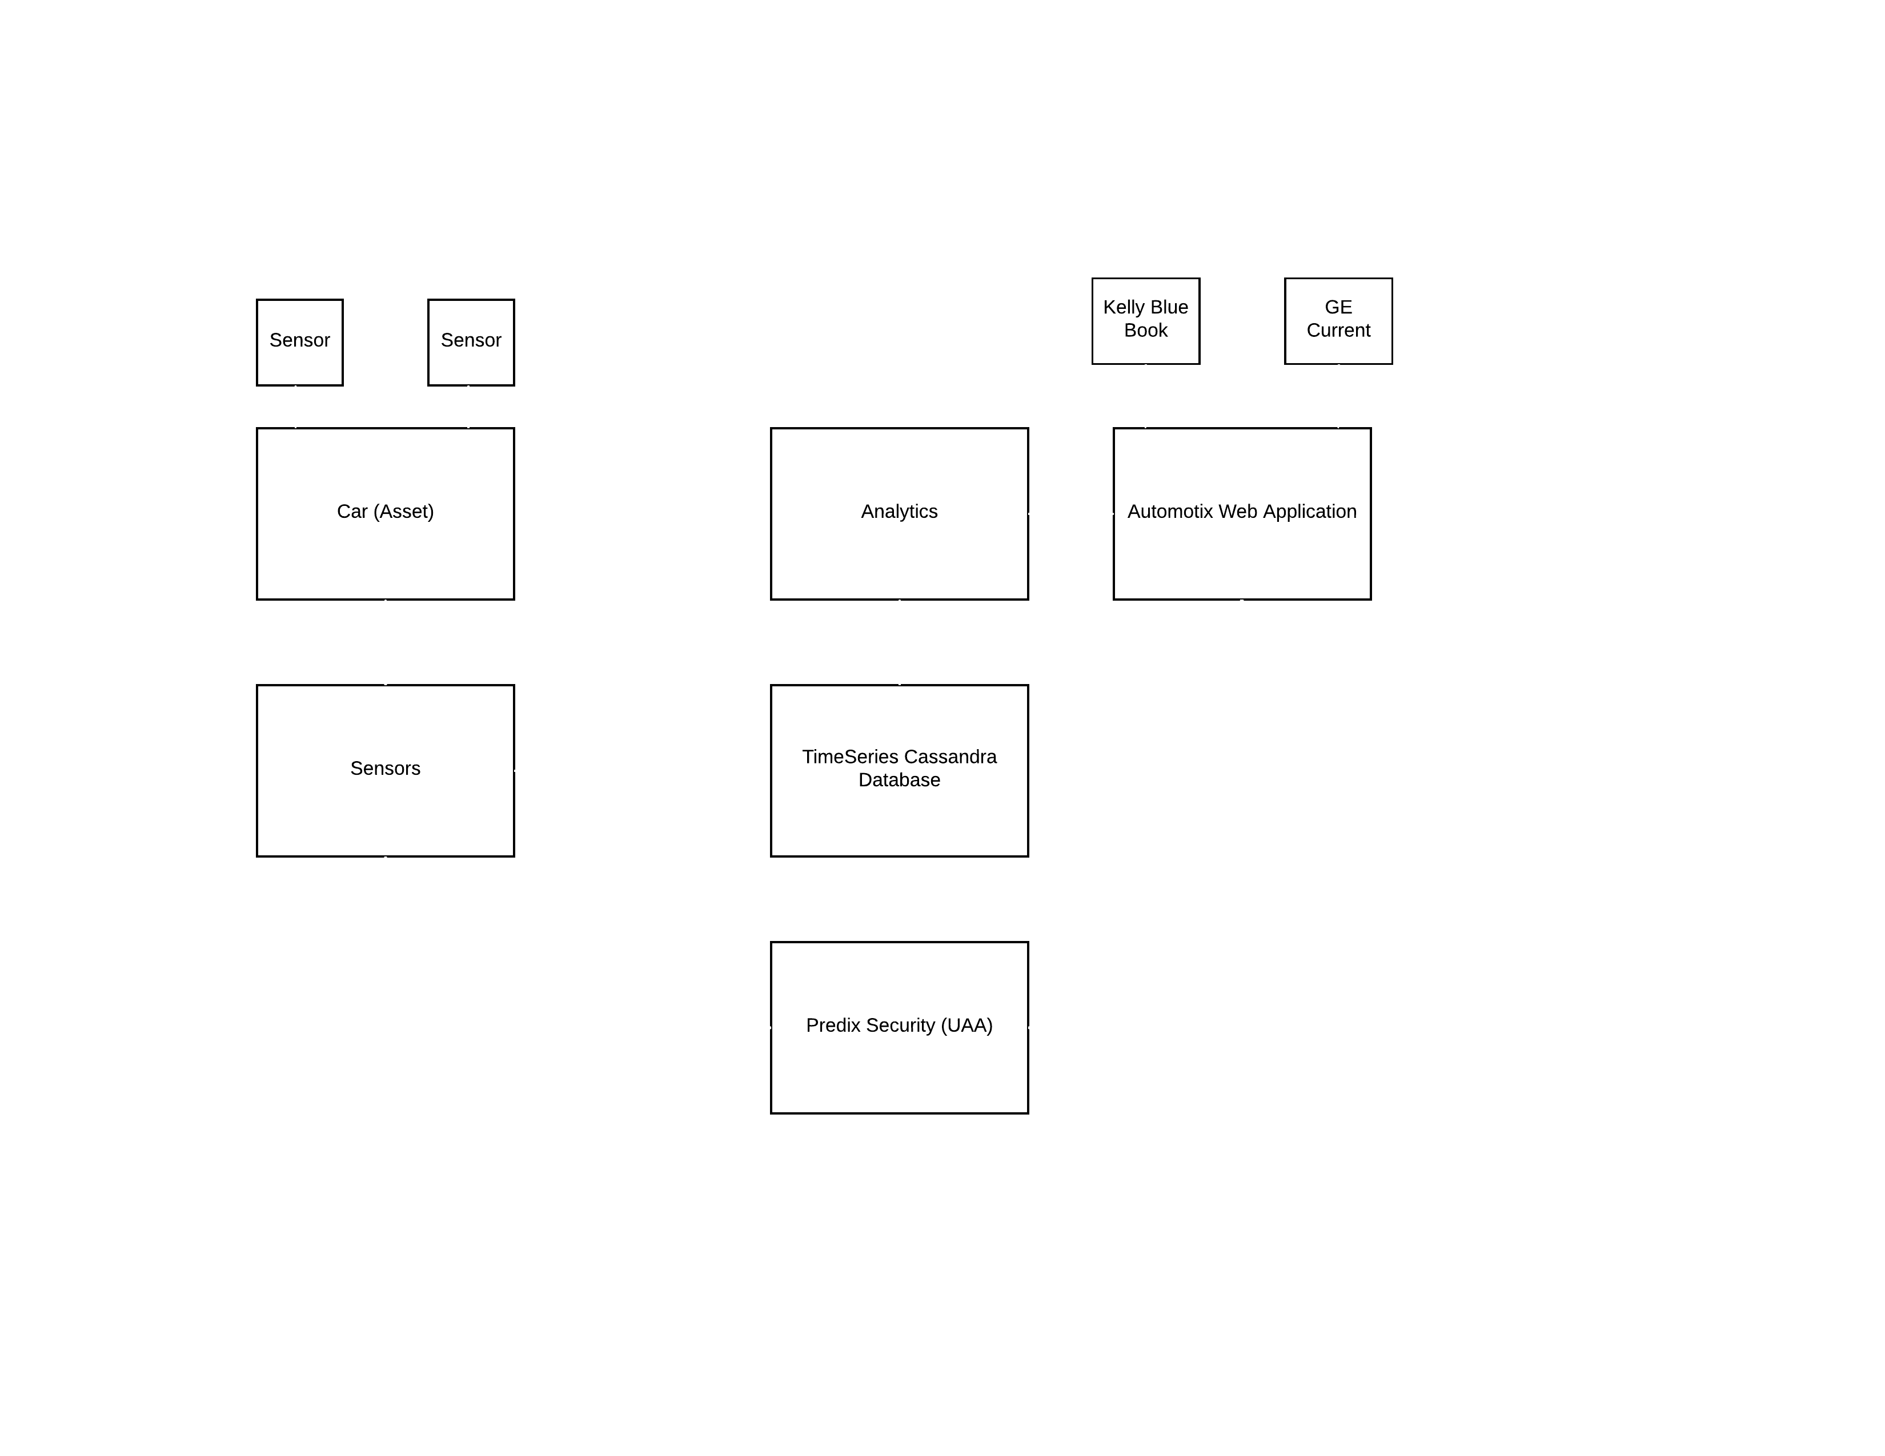
Predix Service Flow

Slide 7

Depreciation Formula
$$D=C_{y}\left(1−F_{y}∗e^{\left(−t\right)}\right)+C_{0}\left(1−F_{0}∗e^{\left(−d\right)}\right)+$$
$$V_{i}^{−1}\left(P_{B}∗B+P_{T}∗T\right)+(C_{H}∗P_{H}+C_{K}P_{K})$$
Car age + distance driven + maintenance + driving style
Over time these constants will be derived from real world sales figures.
This allows for a more complete understanding of a cars condition.

Slide 8
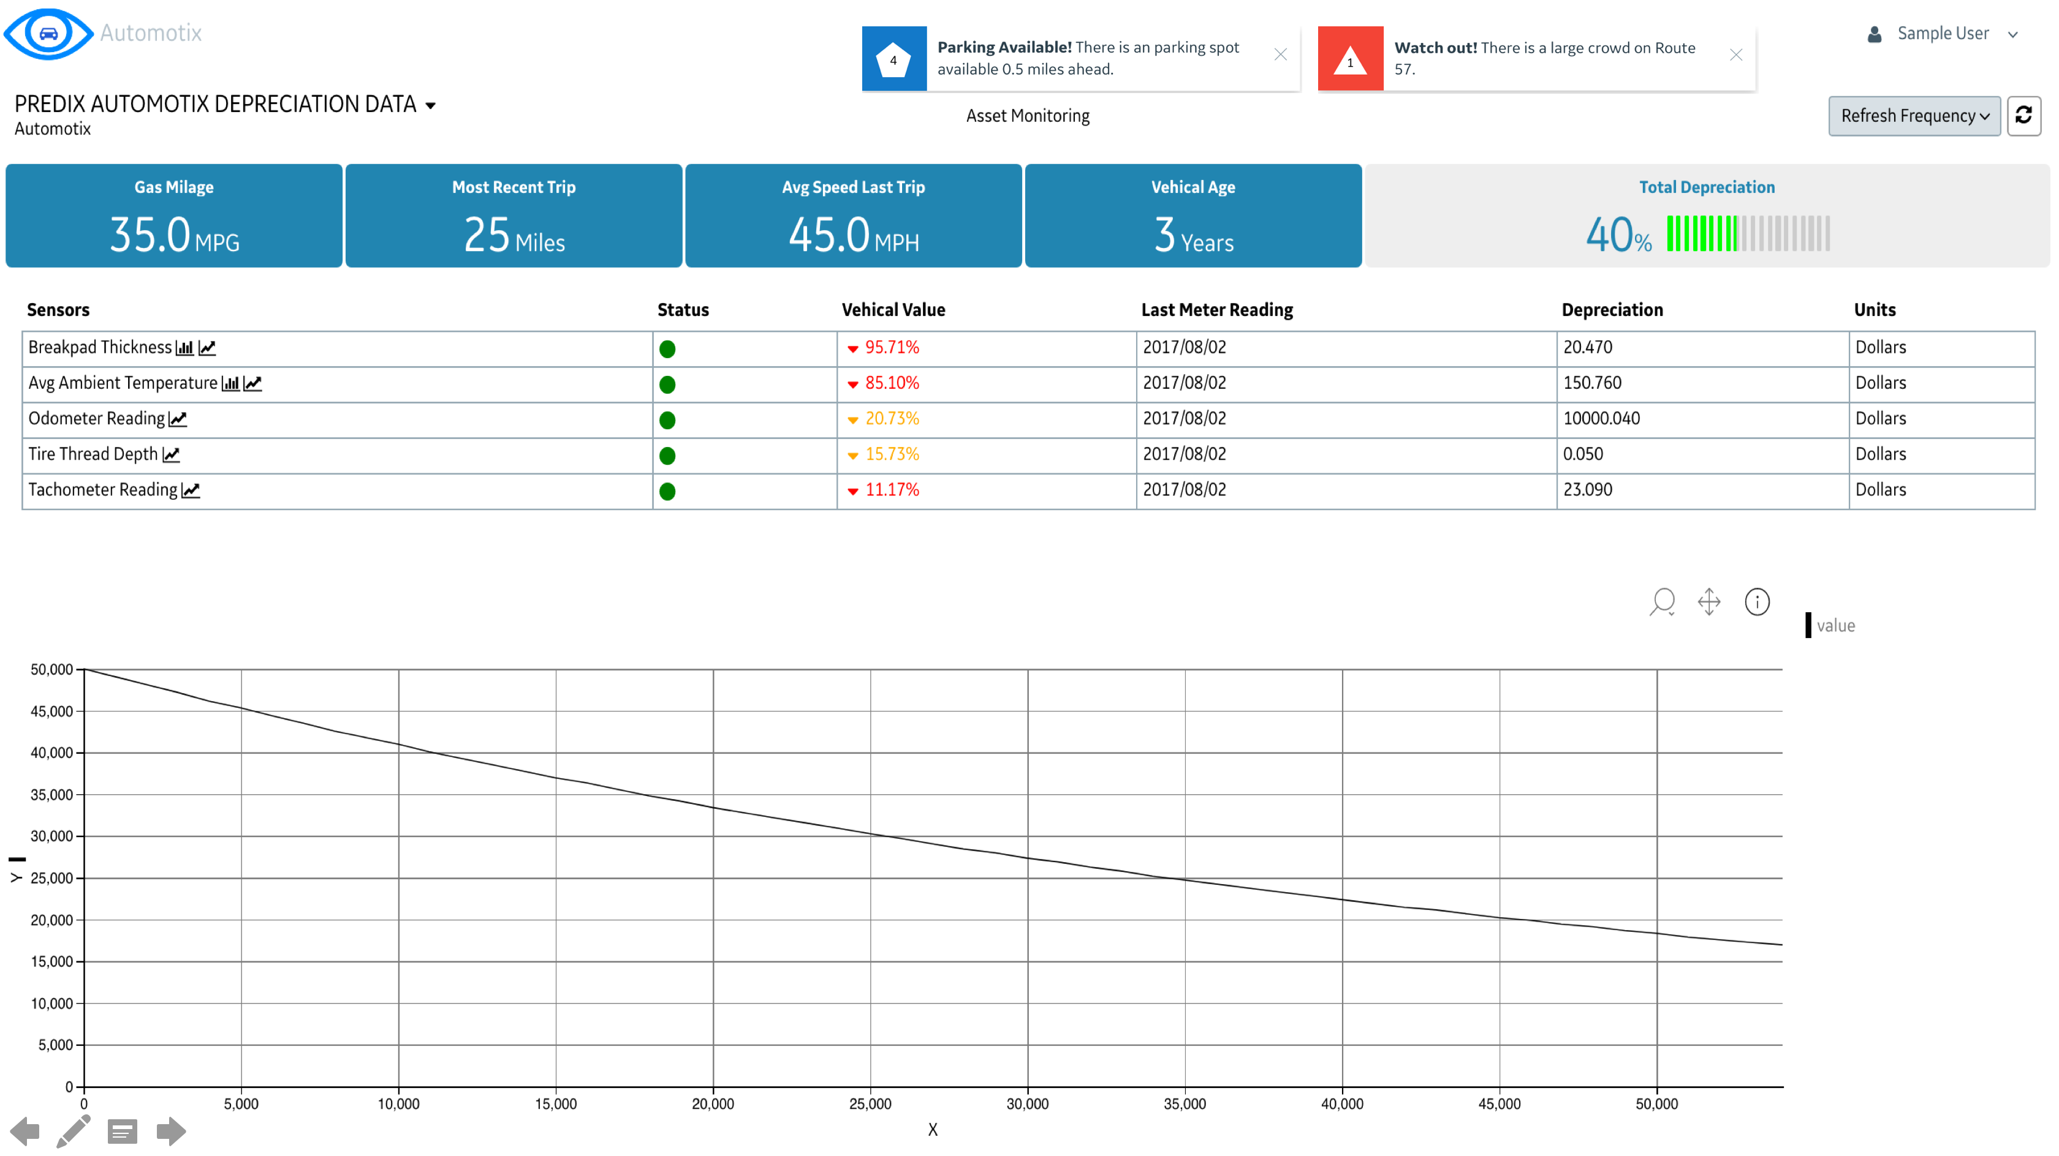

Slide 9
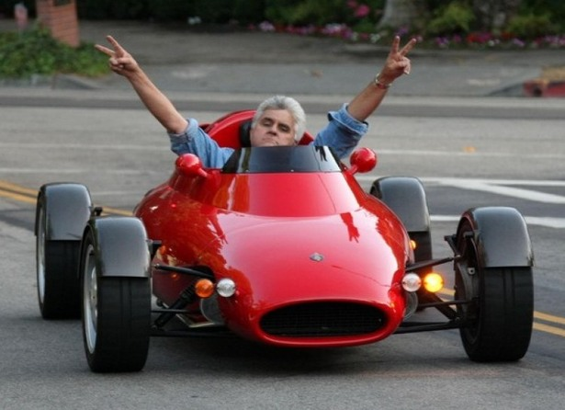

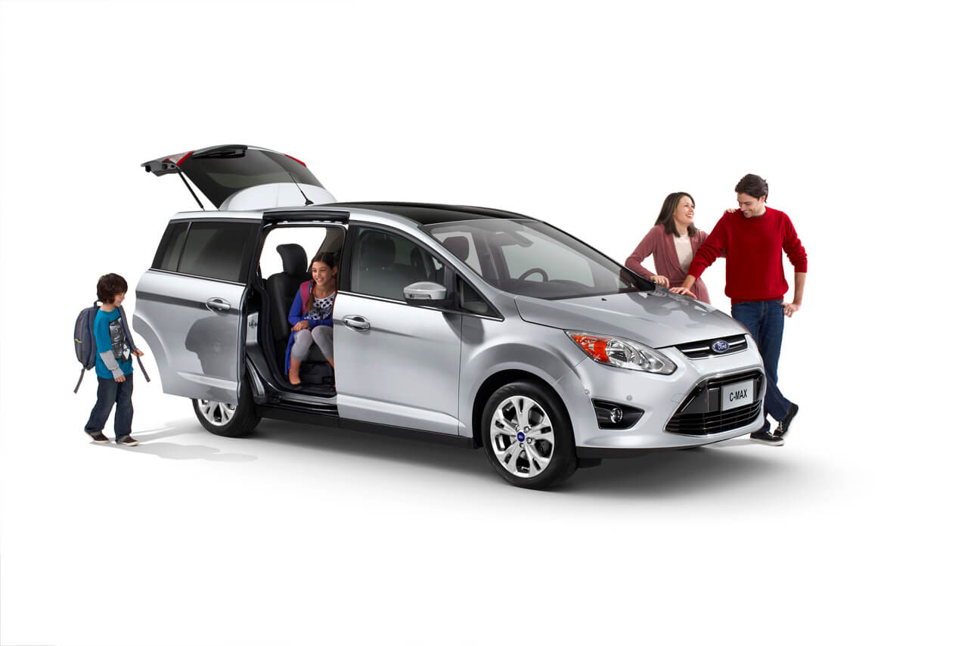
User A User B User C

Slide 10
Price Plan from Predix.io
Service | Description | Quantity | Price per month
Predix Machine/ Edge Manager | Number of managed sensors | 1- 30 | $10.00
Predix Asset | Domain object instances | < 250K | $4.00
Predix UAA | Tokens Issues | < 100K | $2.00
Predix Analytics | Runtime Memory usage & Storage | 0 - 100 per GB hr up to 5 GB Storage | $10.00 - $60.00
Predix Timeseries | 1m data points ingested | 0-10 per million data points | $4.00

Slide 11
Price Plan for Customers
Automotix Standard Plan | Automotix Platinum Plan
Starting at $30.00 / month | $55.00 / month
Limited use Predix services | Unlimited use of Predix services
Access to limited analytics | Access to all analytics
1 TB database storage | 5 TB of database storage
Community Support | Platinum Support

Slide 12
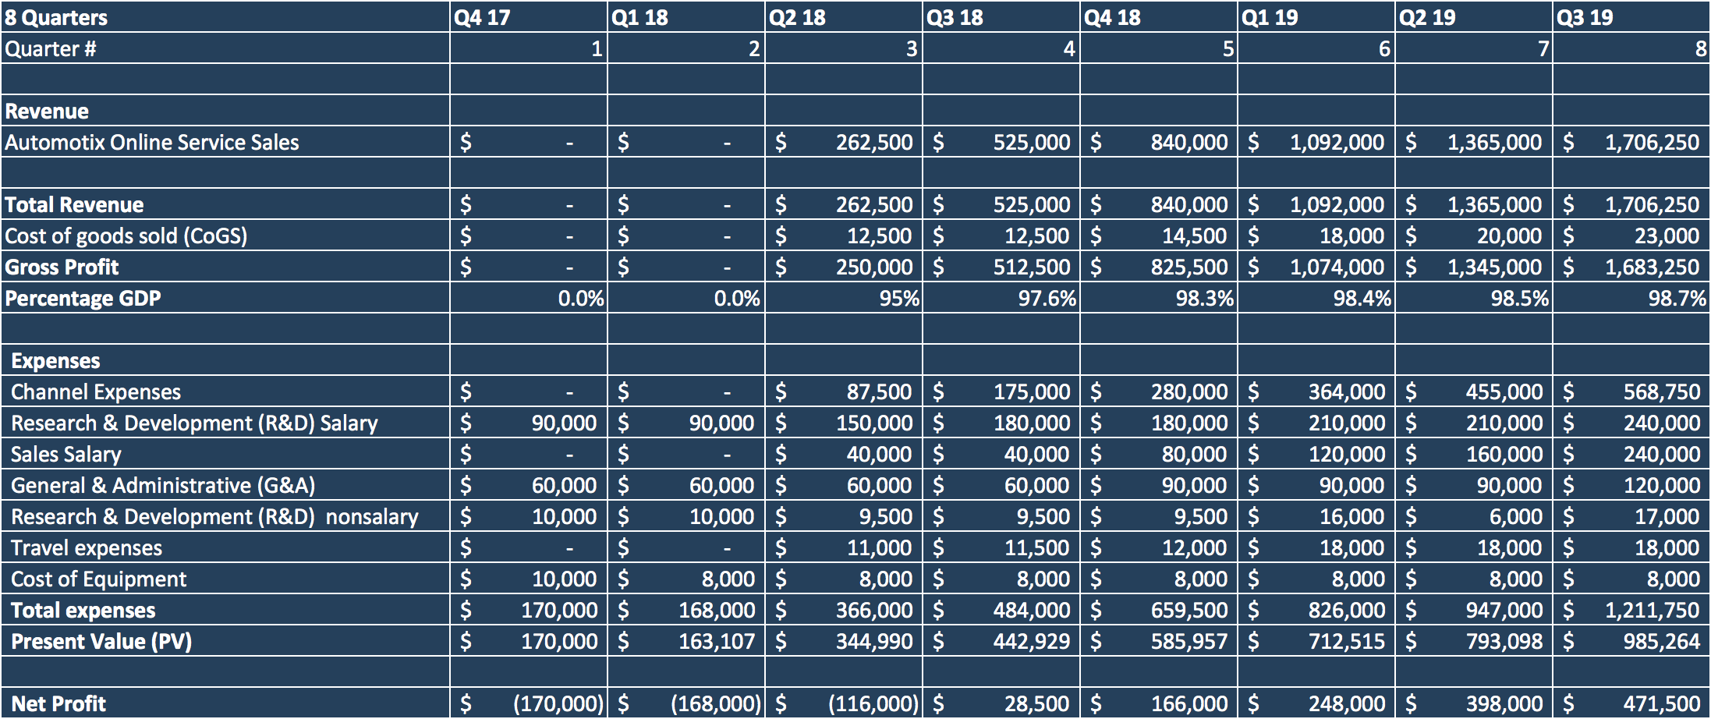
Financial Overview

Slide 13
Timeline 6-9 months
Develop efficient algorithms utilizing machine learning for predictive analytics
Develop GE Current widgets, topology map widgets, service alerts
Mobile phone real time alerts, car infotainment system widgets

Slide 14
Moving Forward
3D Printed Engine Parts with Embedded Sensors
Advanced Analytics with Machine Learning
Phone App
Route Recommendations

